Slide 1

Chapter 4.2
Delay System M/M/n
Performance Evaluation of the Internet of Things (IoT)
Module Course: Performance Evaluation of Distributed Systems
Prof. Tobias Hoßfeld, Summer Semester 2022

Slide 2

Disclaimer and Copyright Notice
Lecture slides, figures, and scripts are based on the open access text book “Performance Modeling and Analysis of Communication Networks”. The book and scripts are licensed under the Creative Commons License Attribution-ShareAlike 4.0 International (CC BY-SA 4.0). If you remix, transform, or build upon the material, you must distribute your contributions under the same license as the original.
The book must be cited and the disclaimer attached when using lectures slides or scripts.
Tran-Gia, P. & Hossfeld, T. (2021). Performance Modeling and Analysis of Communication Networks - A Lecture Note. Würzburg University Press. https://doi.org/10.25972/WUP-978-3-95826-153-2
Website to download book, exercises, slides and scripts: https://modeling.systems/

Slide 3
Chapter 4
4 Analysis of Markovian Systems
4.1 Loss System M/M/n
4.1.1 Model Structure and Parameters
4.1.2 State Process and State Probabilities
4.1.3 Other System Characteristics
4.1.4 Generalization to Loss System M/GI/n
4.1.5 Modeling Examples and Applications
4.2 Delay System M/M/n
4.2.1 Model Structure and Parameters
4.2.2 State Process and State Probabilities
4.2.3 Other System Characteristics
4.2.4 Delay Distribution
4.2.5 Example: Single Server Delay System
4.3 Loss System with Finite Number of Sources
4.3.1 Model Structure and Parameters
4.3.2 State Process and State Probabilities
4.3.3 Example: Mobile Cell with Finite Number of Sources
4.4 Customer Retrial Model with Finite Number of Sources
4.4.1 Model Structure and Parameters
4.4.2 Recursive Analysis Algorithm
4.4.3 Calculation of Traffic Flows
4.4.4 Example: Mobile Cell with Customer Retrials
4.5 Processor Sharing Model M/M/1-PS

Slide 4
Model Structure and Parameters
Stability condition

Slide 5
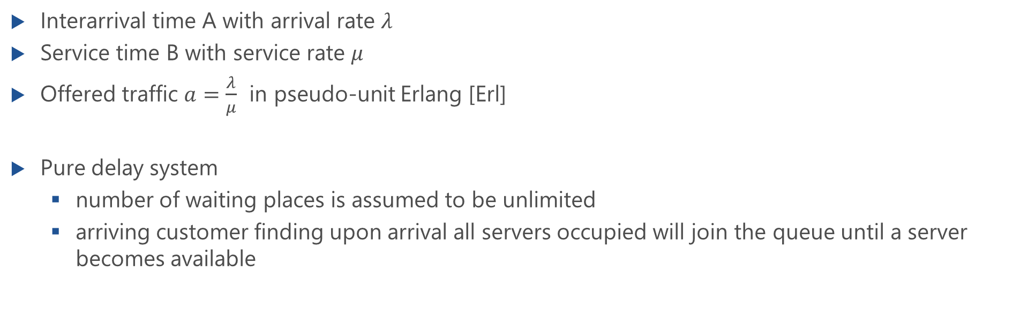
Delay System M/M/n
Interarrival time A with arrival rate $λ$
Service time B with service rate $μ$
Offered traffic $a=\frac{λ}{μ}$ in pseudo-unit Erlang [Erl]
Pure delay system
number of waiting places is assumed to be unlimited
arriving customer finding upon arrival all servers occupied will join the queue until a server becomes available

Slide 6
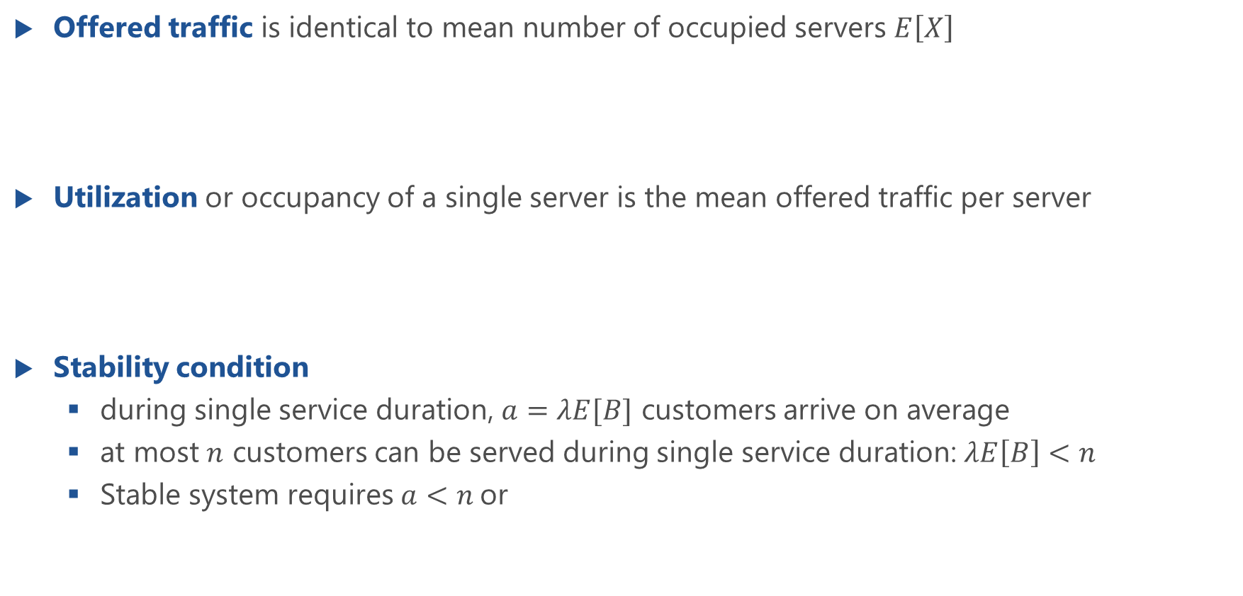
Utilization and Stability Condition
Offered traffic is identical to mean number of occupied servers $E\left[X\right]$
Utilization or occupancy of a single server is the mean offered traffic per server
Stability condition
during single service duration, $a=λE[B]$ customers arrive on average
at most $n$ customers can be served during single service duration: $λE\left[B\right]<n$
Stable system requires $a<n$or

Slide 7
State Process and State Probabilities

Slide 8
State Process of M/M/n Delay System

Slide 9
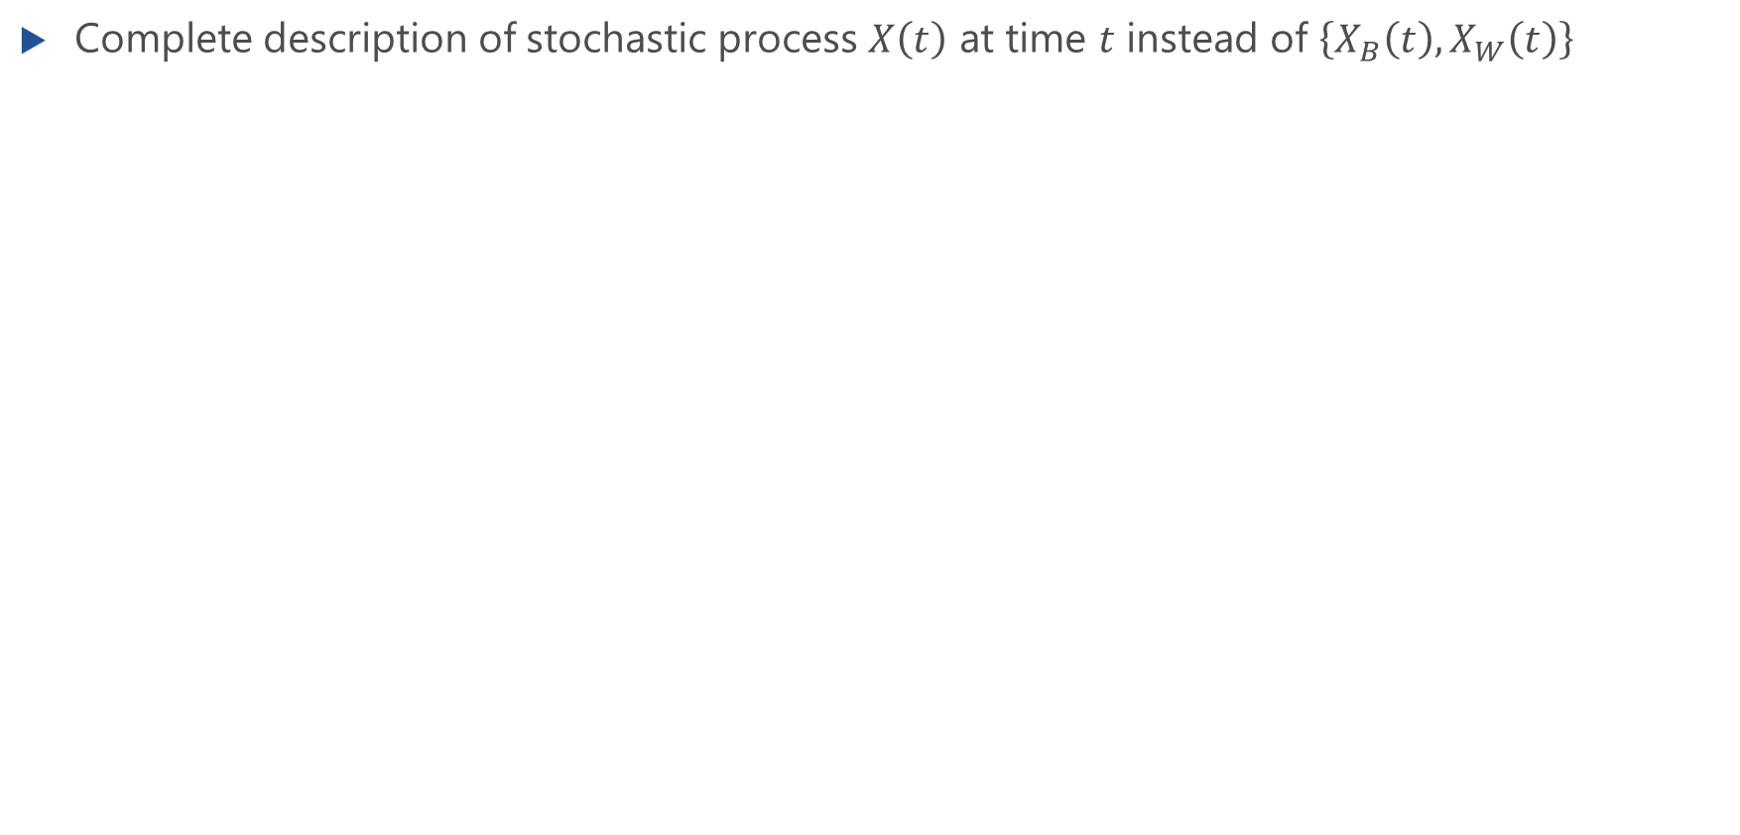
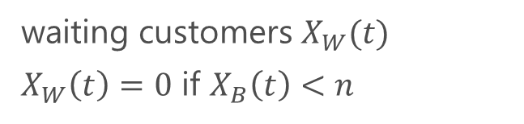
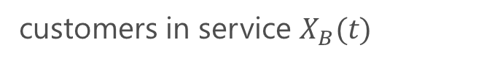
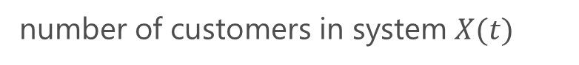
State Process of M/M/n Delay System
Complete description of stochastic process $X\left(t\right)$ at time $t$ instead of $\left\{X_{B}\left(t\right),X_{W}\left(t\right)\right\}$
waiting customers $X_{W}(t)$
$X_{W}\left(t\right)=0$ if $X_{B}\left(t\right)<n$
customers in service $X_{B}(t)$
number of customers in system $X(t)$
⎧
X
B
(t)
for
X
B
(t)
<
n
(X
W
(t)
=
0)
X
(t)
=
⎨
⎩
X
B
(t)
+
X
W
(t)
for
X
B
(t)
=
n
steady state probability

Slide 10
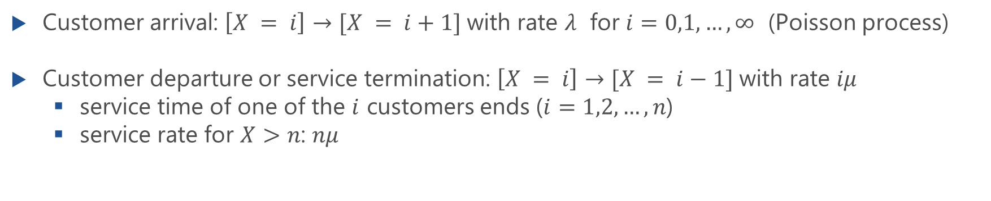
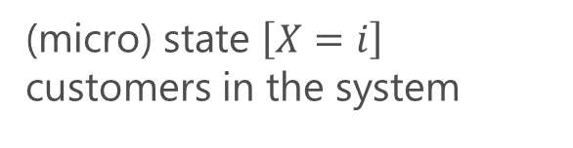
State Transition Diagram
all servers occupied
(micro) state $\left[X=i\right]$ customers in the system
Customer arrival: $\left[X = i\right]→[X = i+1]$with rate $λ$ for $i=0,1,…,∞$ (Poisson process)
Customer departure or service termination: $\left[X = i\right]→[X = i−1]$with rate $iμ$
service time of one of the $i$ customers ends ($i=1,2,…,n$)
service rate for $X>n$: $nμ$

Slide 11
Macro State Equations
Differentiate macro states
Normalization condition

Slide 12
Macro State Equations: Solution
Lecture

Slide 13
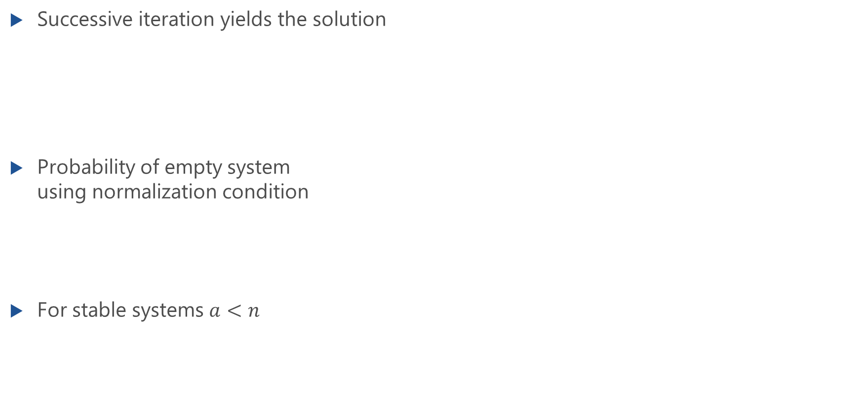
Macro State Equations: Solution
Successive iteration yields the solution
Probability of empty system using normalization condition
For stable systems $a<n$

Slide 14
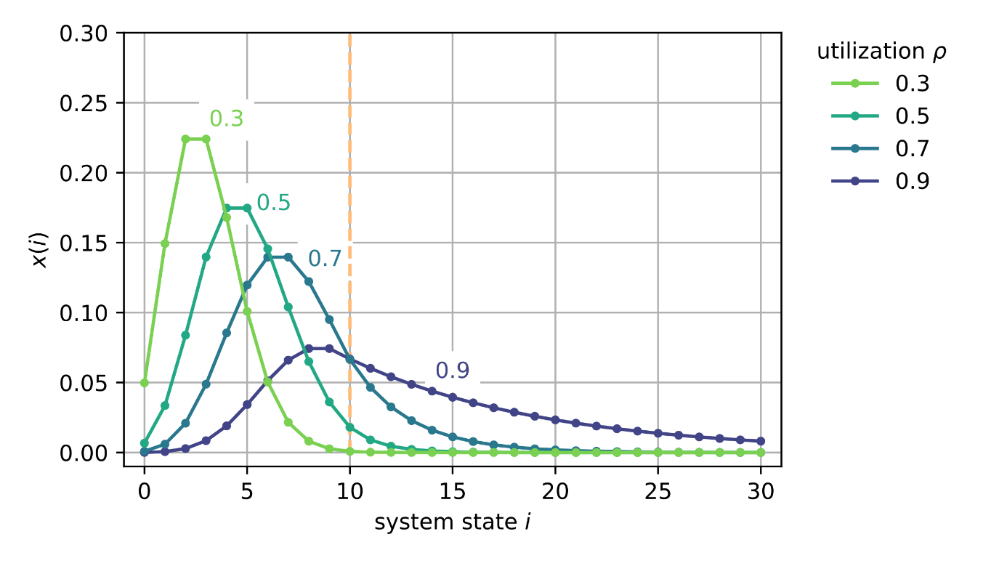
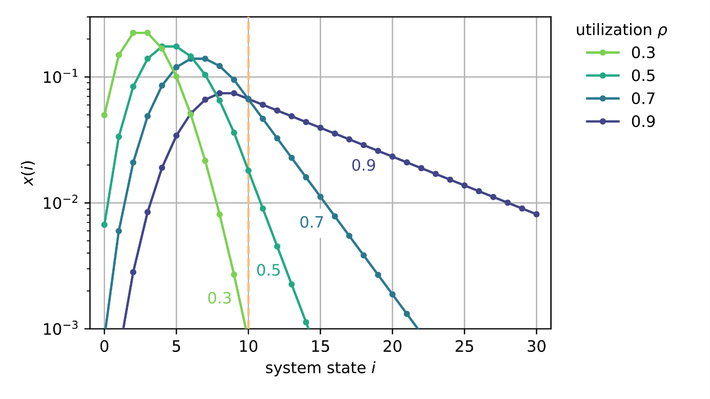
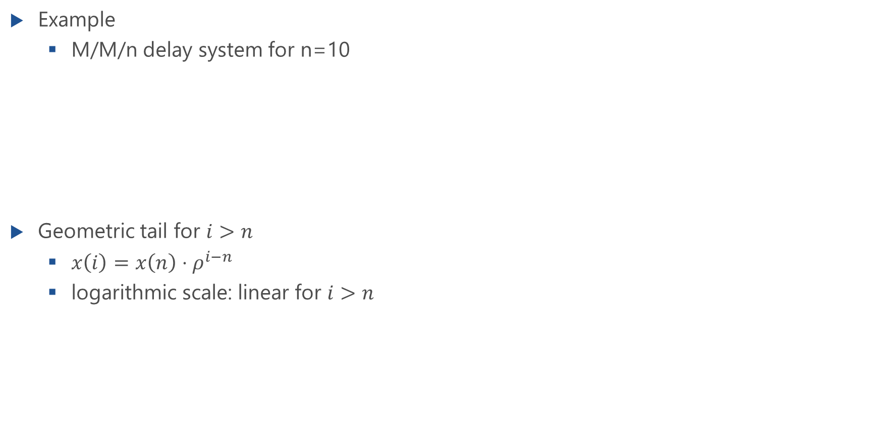
Steady State Distribution
Example
M/M/n delay system for n=10
Geometric tail for $i>n$
$x\left(i\right)=x\left(n\right)⋅ρ^{i−n}$
logarithmic scale: linear for $i>n$

Slide 15
Other System Characteristics
Erlang-C formula, waiting probability, mean waiting times

Slide 16
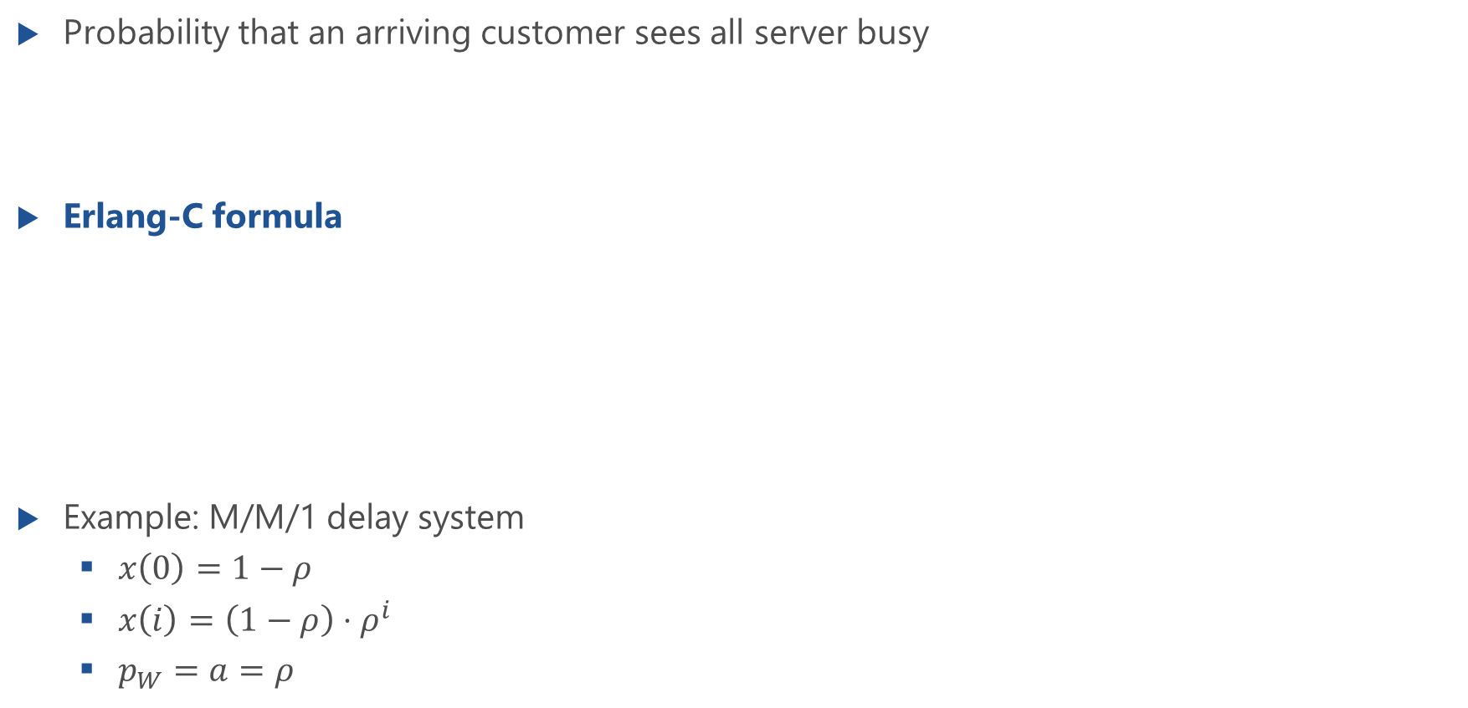
Waiting Probability
Probability that an arriving customer sees all server busy
Erlang-C formula
Example: M/M/1 delay system
$x\left(0\right)=1−ρ$
$x\left(i\right)=\left(1−ρ\right)⋅ρ^{i}$
$p_{W}=a=ρ$

Slide 17
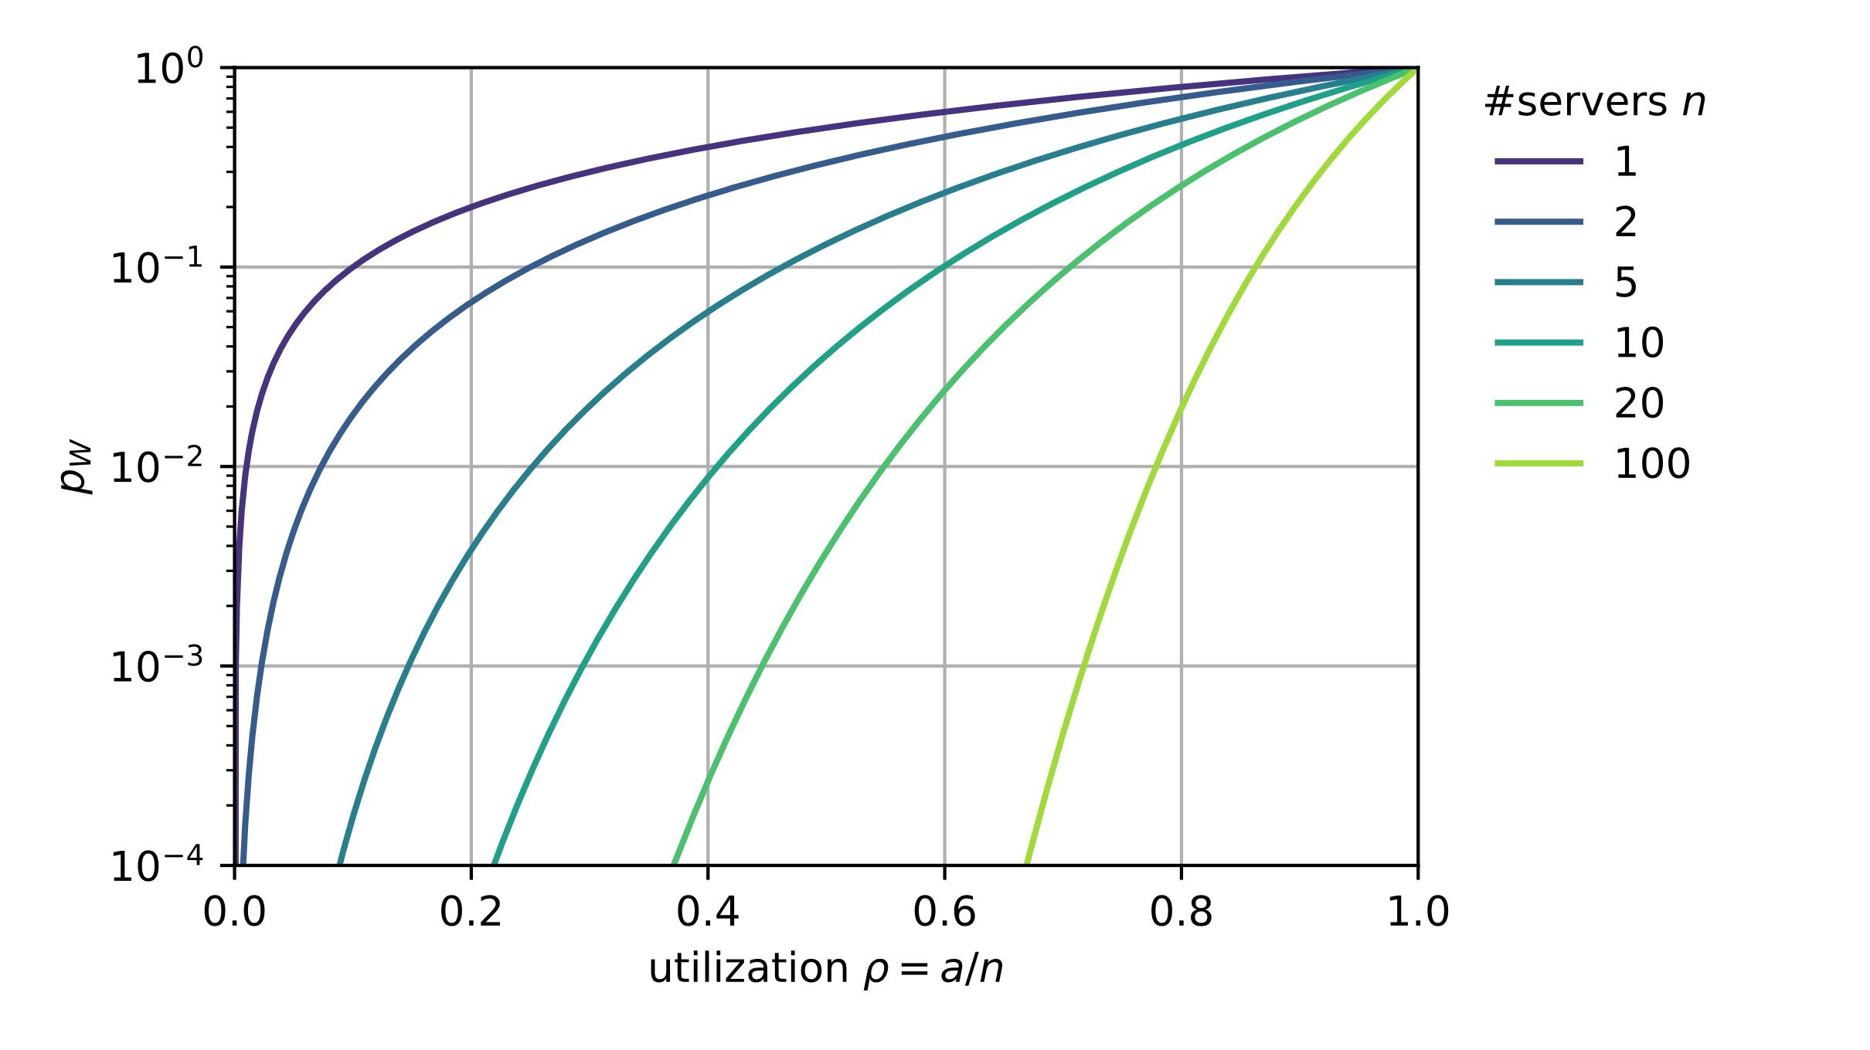
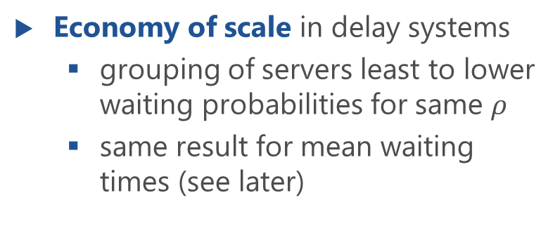
Waiting Probability: Illustration
Economy of scale in delay systems
grouping of servers least to lower waiting probabilities for same $ρ$
same result for mean waiting times (see later)

Slide 18
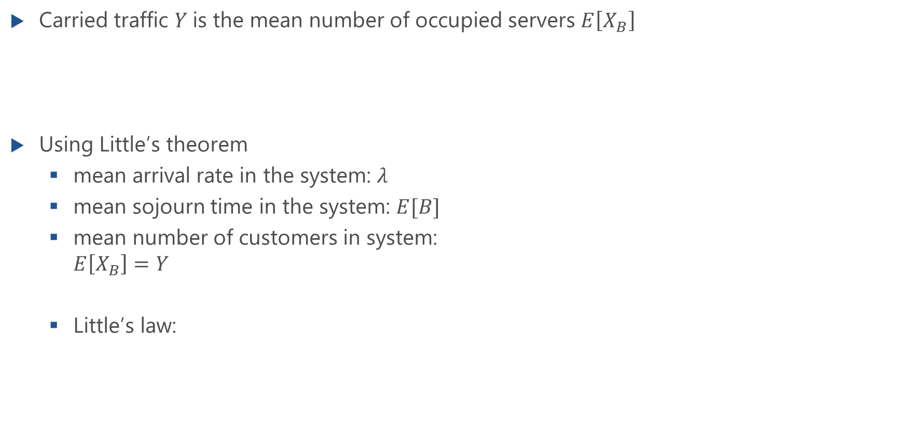
Carried Traffic
Carried traffic $Y$is the mean number of occupied servers $E\left[X_{B}\right]$
Using Little’s theorem
mean arrival rate in the system: $λ$
mean sojourn time in the system: $E[B]$
mean number of customers in system: $E\left[X_{B}\right]=Y$
Little’s law:

Slide 19
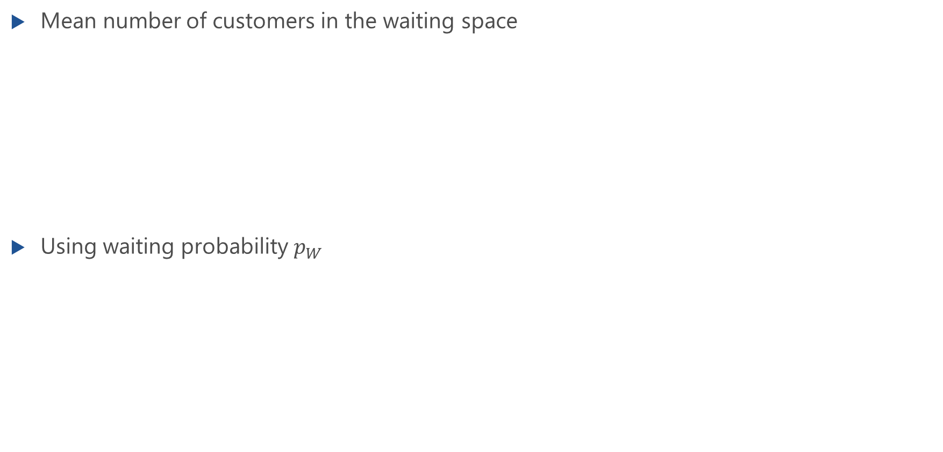
Mean Queue Length
Mean number of customers in the waiting space
Using waiting probability $p_{W}$

Slide 20
Mean Waiting Time
Mean waiting times of all customers (system I) and of waiting customers (system II)

Slide 21
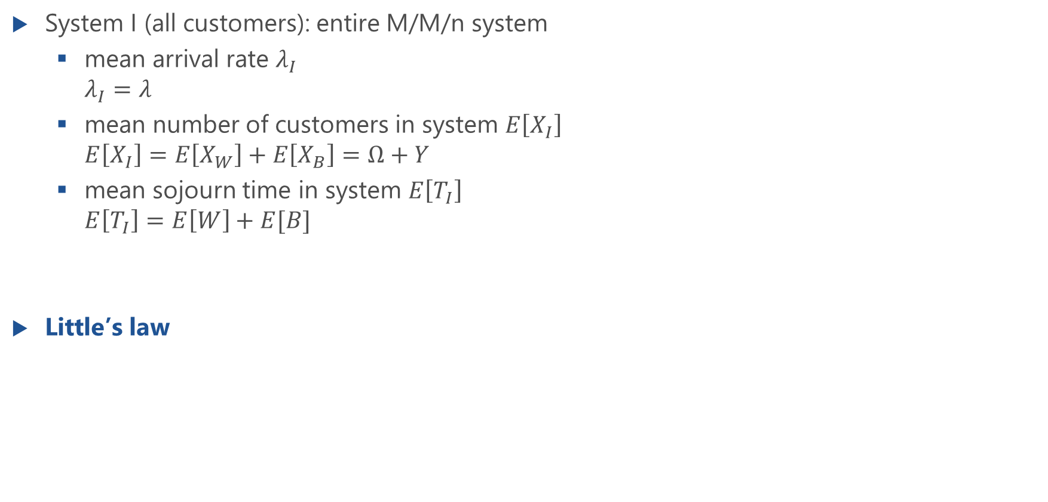
Mean Waiting Time of All Customers (System I)
System I (all customers): entire M/M/n system
mean arrival rate $λ_{I}$ $λ_{I}=λ$
mean number of customers in system $E\left[X_{I}\right]$ $E\left[X_{I}\right]=E\left[X_{W}\right]+E\left[X_{B}\right]=Ω+Y$
mean sojourn time in system $E\left[T_{I}\right]$ $E\left[T_{I}\right]=E\left[W\right]+E[B]$
Little’s law

Slide 22
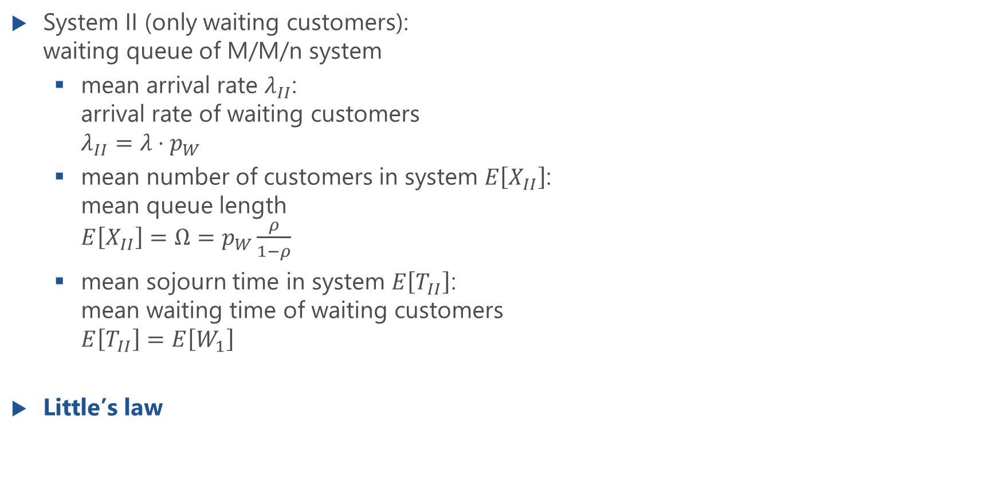
Mean Waiting Time of Waiting Customers (System II)
System II (only waiting customers): waiting queue of M/M/n system
mean arrival rate $λ_{II}$: arrival rate of waiting customers $λ_{II}=λ⋅p_{W}$
mean number of customers in system $E\left[X_{II}\right]$: mean queue length $E\left[X_{II}\right]=Ω=p_{W}\frac{ρ}{1−ρ}$
mean sojourn time in system $E\left[T_{II}\right]$: mean waiting time of waiting customers $E\left[T_{II}\right]=E\left[W_{1}\right]$
Little’s law

Slide 23
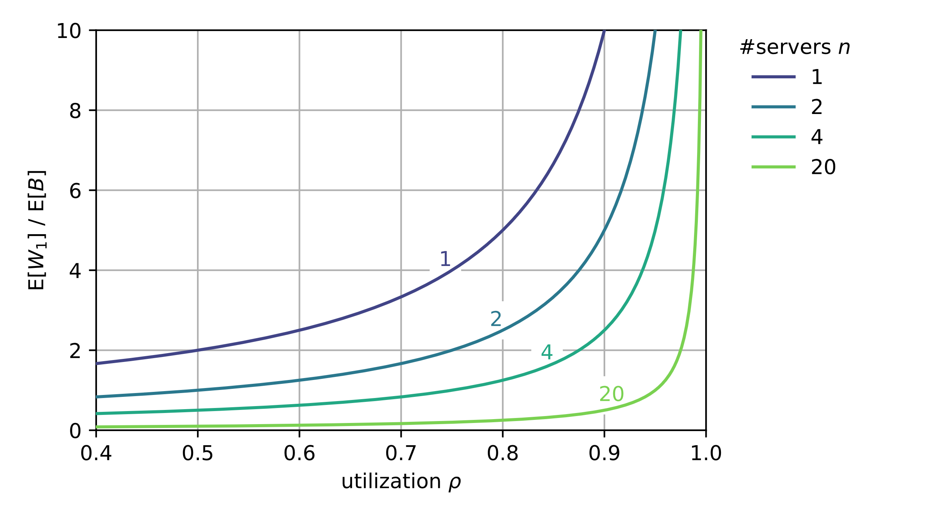
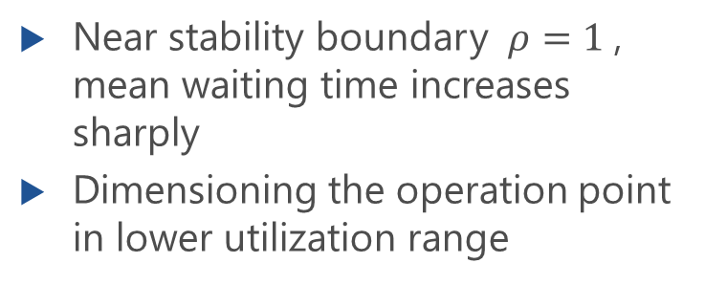
Mean Waiting Time of Waiting Customers
Near stability boundary $ρ=1$, mean waiting time increases sharply
Dimensioning the operation point in lower utilization range

Slide 24
Delay Distribution
Waiting time distribution

Slide 25
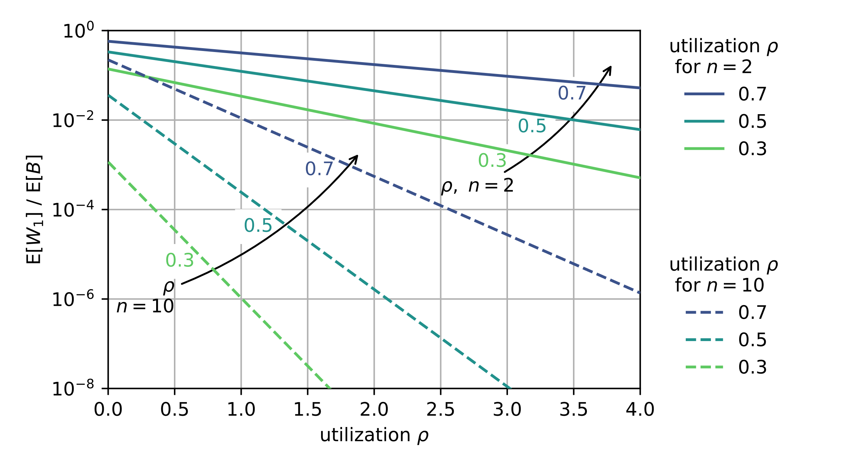
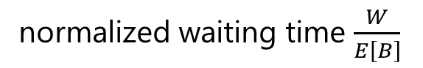
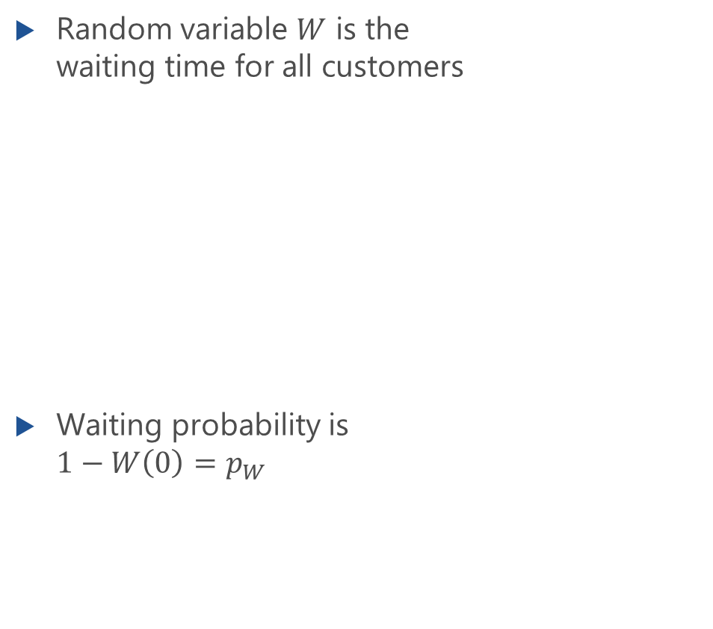
Waiting Time Distribution for All Customers
Random variable $W$ is the waiting time for all customers
Waiting probability is $1−W\left(0\right)=p_{W}$
CCDF
normalized waiting time $\frac{W}{E\left[B\right]}$

Slide 26
Waiting Time Distribution: Derivation
Lecture

Slide 27
Waiting Time Distribution: Derivation (f.)
Lecture

Slide 28
Examples
Waiting time distribution, economy of scale

Slide 29
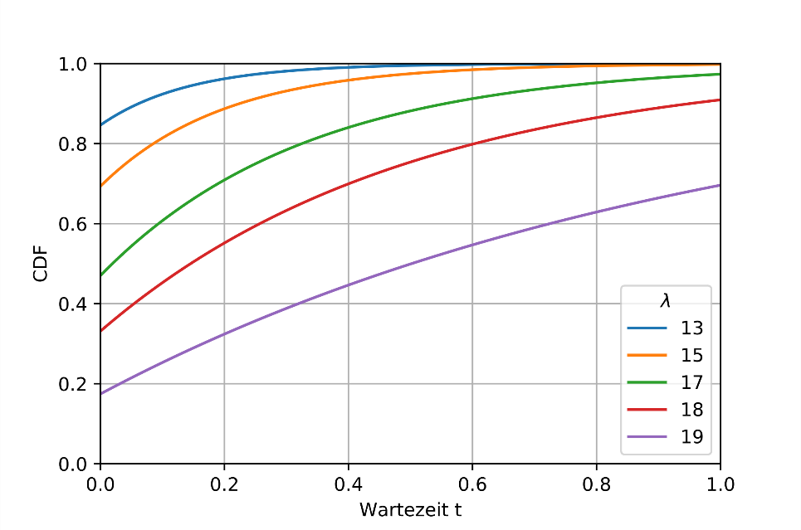
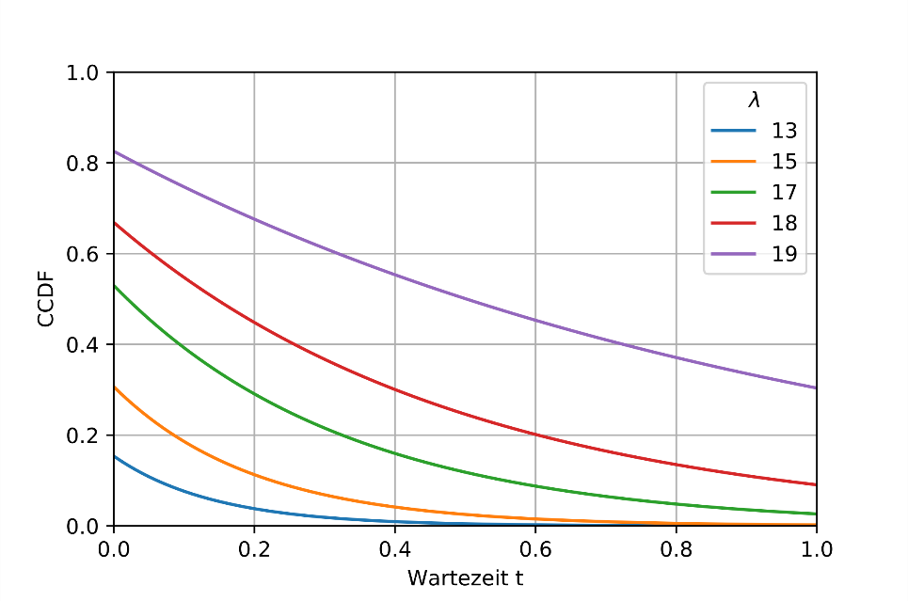
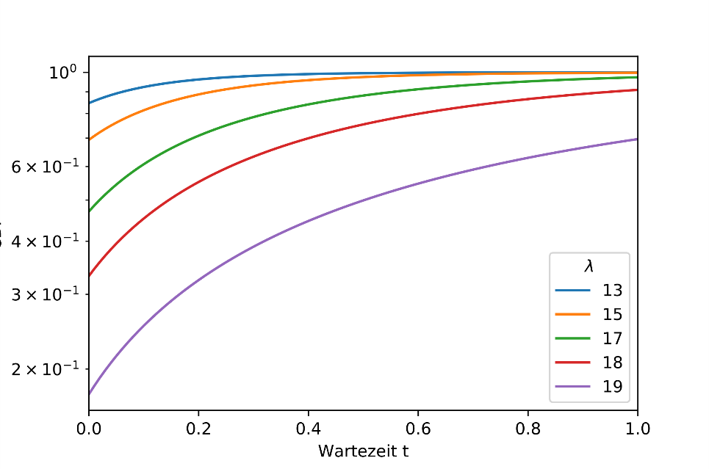
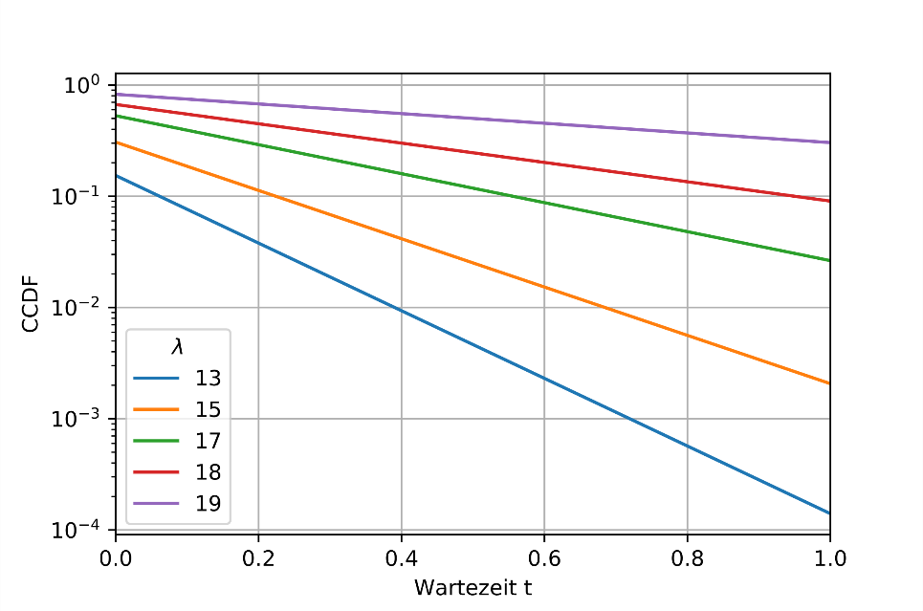
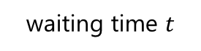
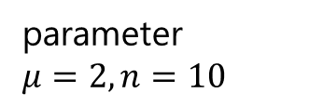
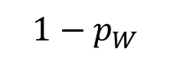

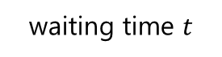

Example: Waiting Time Distributions M/M/n
$$1−p_{W}$$
linear scale
CDF
CCDF
parameter
$$μ=2, n=10$$
waiting time $t$
waiting time $t$
logarithmic scale
CDF
CCDF
waiting time $t$
waiting time $t$

Slide 30
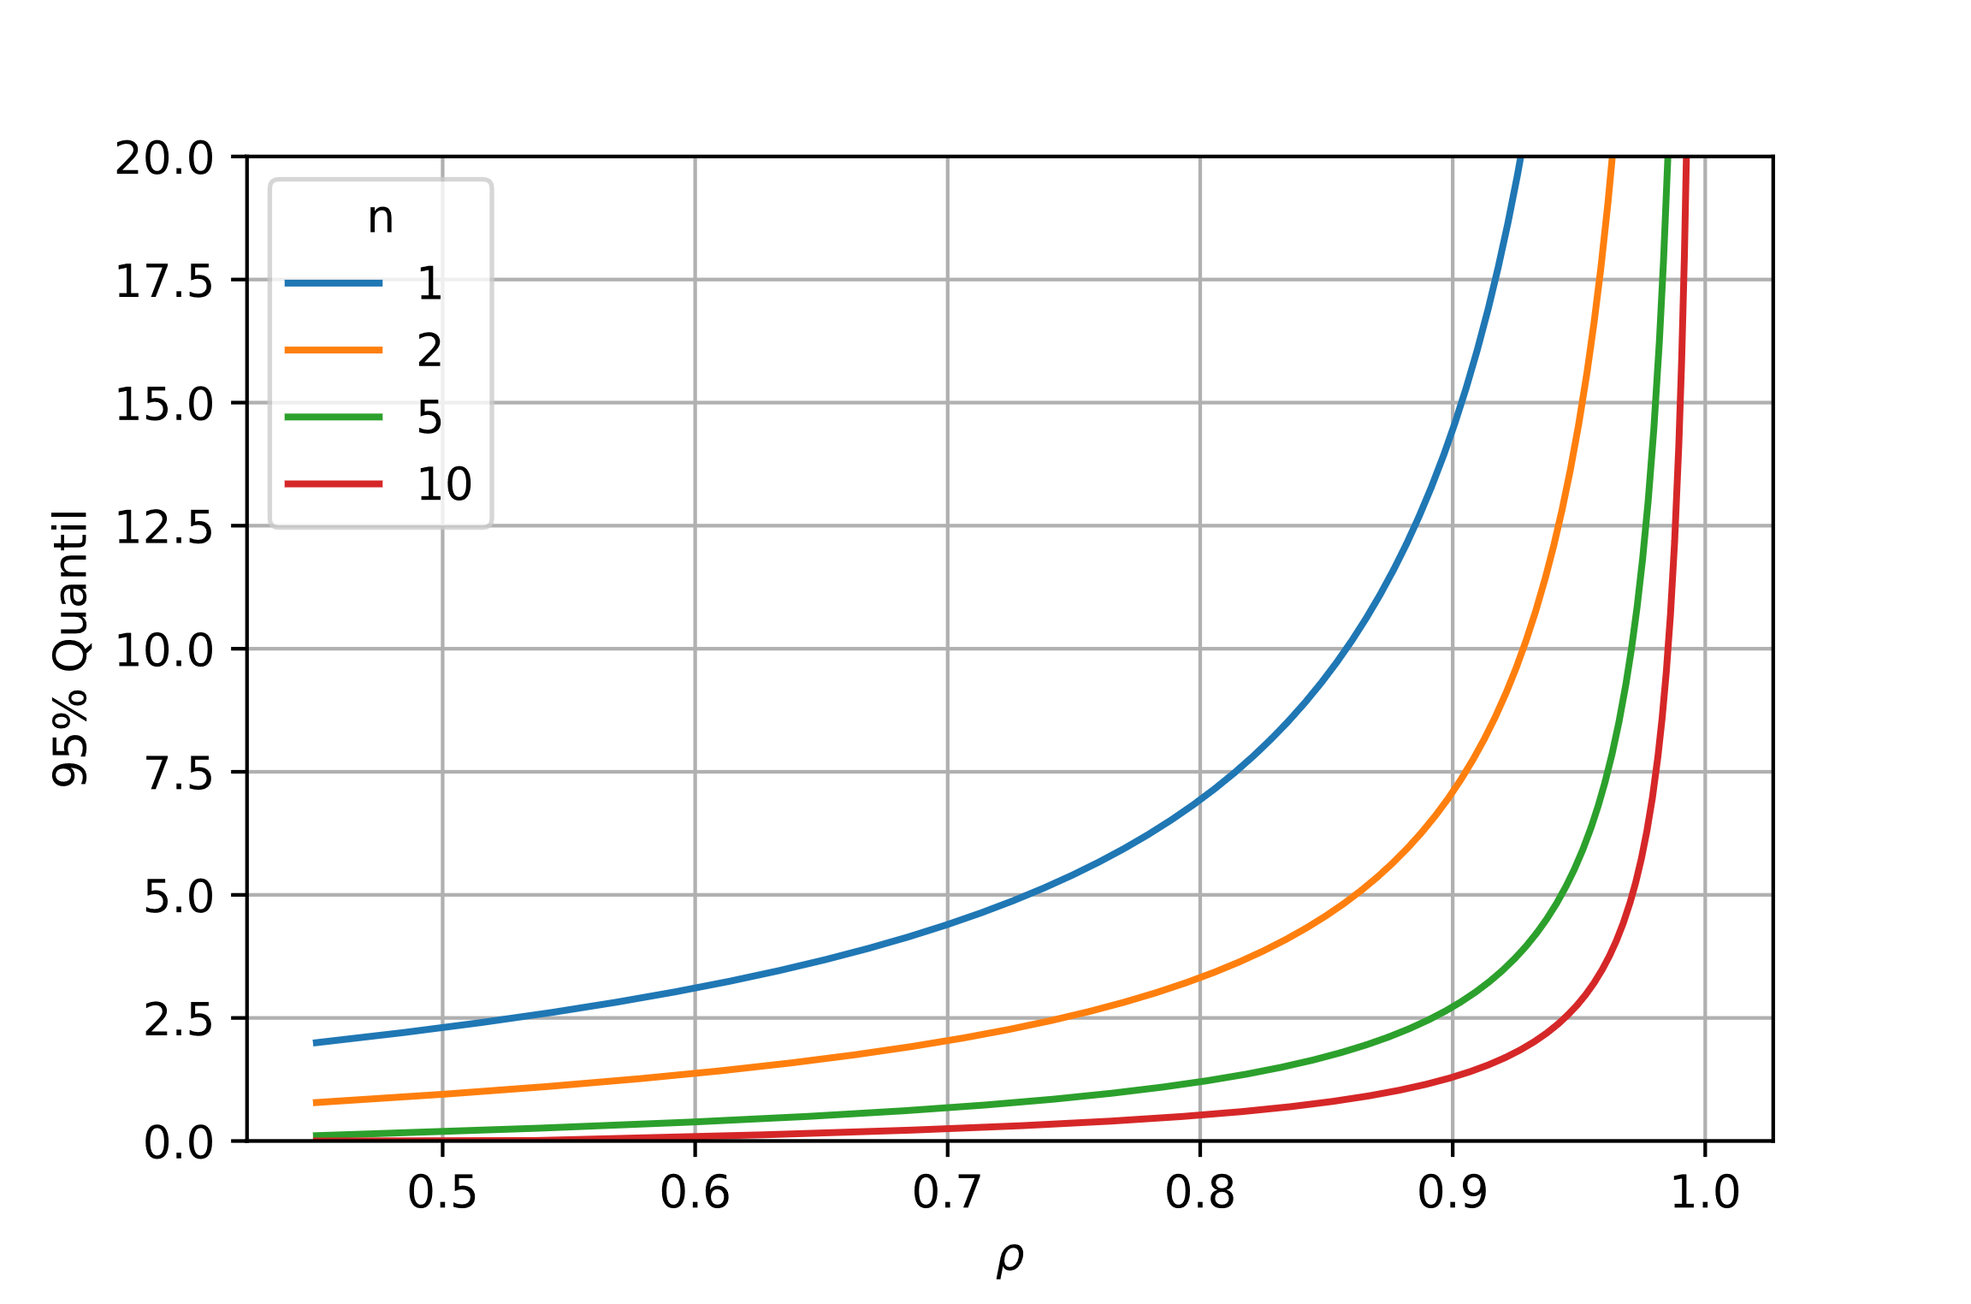
Quantiles of Waiting Times
95% Quantile of waiting time

Slide 31
Economy of Scale for Delay Systems
Teilsystem 1a
Subsystem 1a
1
M
1
λ
M
λ
= λ
= λ
.
.
1
.
1
.
.
.
.
.
.
p
p
W
W
W
W
n
n
M
1
M
1
1
1
1
M
1
M
λ
λ
=
=
λ
2
λ
μ
2
μ
2
2
M
M
2
2
.
.
.
.
.
p
.
p
.
.
W
.
Teilsystem 1b
W
Subsystem 1b
W
W
2
2
2
grouping
2
1
M
1
λ
M
λ
= λ
= λ
M
M
2n
.
2n
.
1
.
1
.
.
.
μ
.
μ
.
.
p
p
W
W
W
W
n
1
n
1
1
1
M
M
μ
System 2
μ
System 1

